Slide 1
Greedy Method

Slide 2
A greedy algorithm always makes the choice that looks best at the moment.
It makes a locally optimal choice in the hope that this choice will lead to a globally optimal solution.
Greedy algorithms do not always yield optimal solutions, but for many problems they do.

Slide 3
Optimization problems
An optimization problem is one in which you want to find, not just a solution, but the best solution
A “greedy algorithm” sometimes works well for optimization problems
A greedy algorithm works in phases. At each phase:
  You take the best you can get right now, without regard for future consequences
  You hope that by choosing a local optimum at each step, you will end up at a global optimum
Notes:
2

Slide 4
A scheduling problem
You have to run nine jobs, with running times of 3, 5, 6, 10, 11, 14, 15, 18, and 20 minutes
You have three processors on which you can run these jobs
You decide to do the longest-running jobs first, on whatever processor is available
P1
P2
P3
20
10
3
18
11
6
15
14
5
Time to completion: 18 + 11 + 6 = 35 minutes
This solution isn’t bad, but we might be able to do better
Notes:
5

Slide 5
Another approach
What would be the result if you ran the shortest job first?
Again, the running times are 3, 5, 6, 10, 11, 14, 15, 18, and 20 minutes
P1
P2
P3
3
10
15
5
11
18
6
14
20
That wasn’t such a good idea; time to completion is now
6 + 14 + 20 = 40 minutes
Note, however, that the greedy algorithm itself is fast
  All we had to do at each stage was pick the minimum or maximum
Notes:
6

Slide 6
An optimum solution
Better solutions do exist:
P1
P2
P3
20
14
18
11
5
15
10
6
3
This solution is clearly optimal (why?)
Clearly, there are other optimal solutions (why?)
How do we find such a solution?
  One way: Try all possible assignments of jobs to processors
  Unfortunately, this approach can take exponential time
Notes:
7

Slide 7
Fractional Knapsack Problem
We are given n objects and a bag or knapsack.
Object i has a weight w _{i}
the knapsack has a capacity m.
If a fraction x _{I ,}0 ≤ x _{i} ≤ 1 of
Object i is placed into the bag then a profit of p_{i} x _{i} is earned.
The objective is to obtain a filling of the knapsack that maximizes the total profit earned.

Slide 8
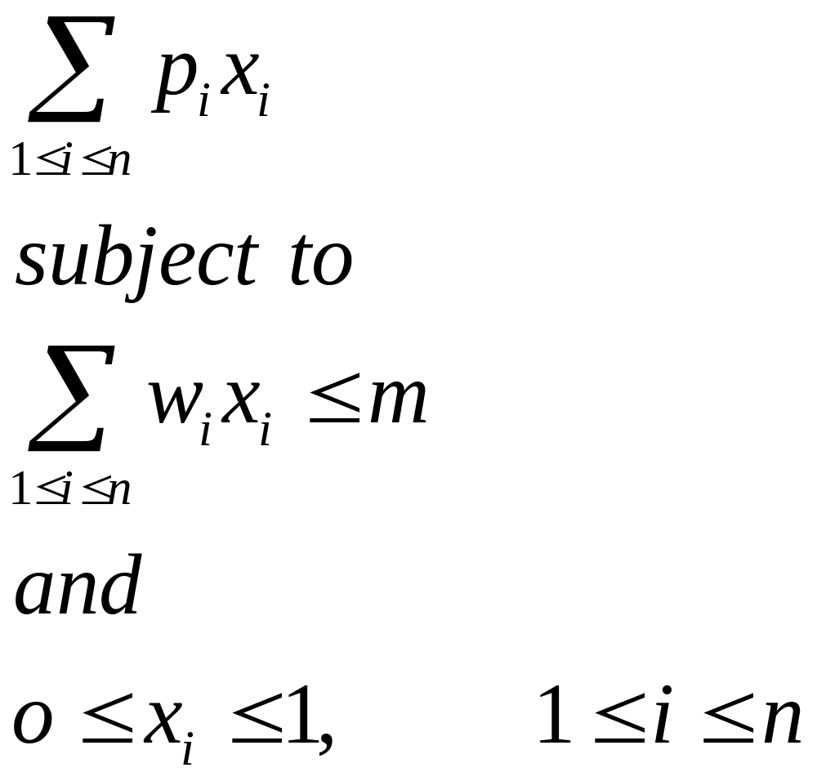
    Maximize
A feasible solution is any set ( x ₁ ,…. x _{n} ) satisfying the above inequalities. An optimal solution is a feasible solution for which objective function is maximized.

Slide 9
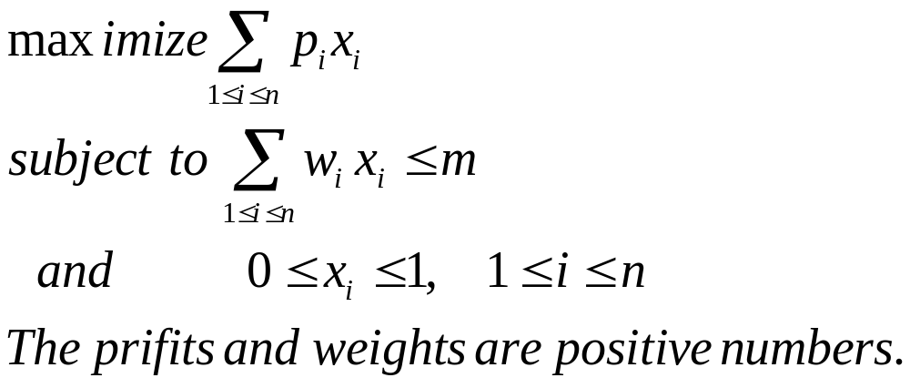
0-1 knapsack problem
Xi are o or 1

Slide 10


Slide 11
Greedy Algorithms for Knapsack Problem
We can fill the bag by including next object with largest profit.

Slide 12
Example: n= 3, m = 20,
(p₁ ,p ₂ , p ₃ ) = (25 , 24, 15)
(w ₁ , w ₂ , w ₃ ) = (18 , 15 , 10)
By above strategy solution is
x ₁ = 1 , x ₂ = 2/15, x ₃ = 0
Total weight = 20, profit = 28.2

Slide 13
But this solution is not the best one.
(0,1,1/2) is a better solution
having profit 31.5

Slide 14
Example: n= 3, m = 20,
(p₁ ,p ₂ , p ₃ ) = (25 , 24, 15)
(w ₁ , w ₂ , w ₃ ) = (18 , 15 , 10)
To become greedy w.r.t. capacity:
Start with lightest object and so on:
(0 ,2/3 , 1) with profit = 31
Again not an optimal solution.
(0,1,1/2) is a better solution having profit 31.5

Slide 15
New greedy approach
With a balance between weight and profit
At each step we include that object which has the maximum profit per unit of capacity used.
Using this strategy solution obtained is:
(0, 1 , ½) with profit = 31.5
Which is an optimal solution for this example.

Slide 16
So this strategy gave optimal solution for this data:
In fact we can prove that this strategy will give optimal solution for any data.
.

Slide 17
There seem to be 3 obvious greedy strategies:
(Max value) Sort the objects from the highest value to the lowest, then pick them in that order.
(Min weight) Sort the objects from the lowest weight to the highest, then pick them in that order.
(Max value/weight ratio) Sort the objects based on the value to weight ratios, from the highest to the lowest, then select.

Slide 18
Example: Given n = 5 objects and a knapsack capacity
W = 100 as in Table I. The three solutions are given in Table II.
select x_{i} value Max v_{i} 0 0 1 0.5 1 146 Min w_{i} 1 1 1 1 0 156 Max v_{i}/w_{i} 1 1 1 0 0.8 164
w 10 20 30 40 50 v 20 30 66 40 60 v/w 2.0 1.5 2.2 1.0 1.2

Slide 19
The Optimal Knapsack Algorithm:
Algorithm (of time complexity O(n lgn))
Sort the n objects from large to small based on the ratios v_{i}/w_{i} . We assume the arrays w[1..n] and v[1..n]
store the respective weights and values after sorting.
initialize array x[1..n] to zeros. weight = 0; i = 1
while (i ≤ n and weight < W) do (4.1) if weight + w[i] ≤ W then x[i] = 1 (4.2) else x[i] = (W – weight) / w[i] (4.3) weight = weight + x[i] * w[i] (4.4) i++

Slide 20
Prove that the fractional knapsack problem has the greedy-choice property.
Let I th item has maximum Vi/Wi
We will show that optimal solution will have i th item

Slide 21
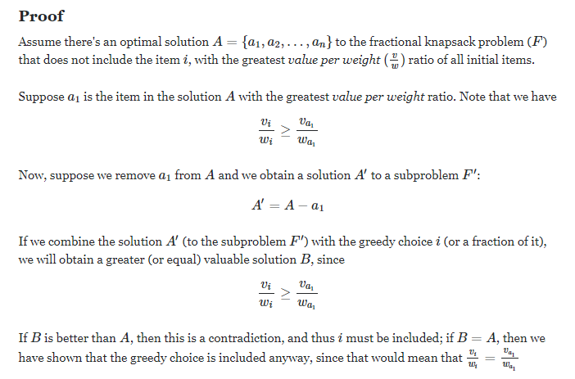

Slide 22
Theorem: If p1 /w1 ≥ p2/ w2 ≥ …pn/wn .then selecting items w.r.t. this ordering gives an optimal solution.
Proof: Let x = (x₁ , …x _{n}) be the solution so generated.
By obvious reasons Σwi xi = m full w.r t capacity
If all the xi’s are one then clearly the solution is optimal.

Slide 23
let j be the least index such that xj ≠ 1.
So x i = 1 for all 1 ≤ i < j and
xi = 0 for j < i ≤ n and 0 ≤ xj <1.
Let y= (y1 , y2 ,…yn) be an optimal solution
X = 1 1 1 ……1 X_{j} 0 0 0 0 0 0

Slide 24
X = 1 1 1 ……1 X_{j} 0 0 0 0 0 0
Y = y₁ y₂ y_{k} y _{k+1……………..}
Z= z1 , z2, … zn
Let k be the least index such that yk ≠ xk.
It is easy to reason that yk < xk.
Now suppose we increase yk to xk and decrease as many of (yk+1, …. Yn) as necessary so that total capacity of bag is
still m.

Slide 25
This results in a new solution
Z = (z1 , z2, …zn)
zi = xi 1≤ i ≤ k
And
∑ wi (yi - zi ) = wk( zk – yk)
k < i ≤n

Slide 26
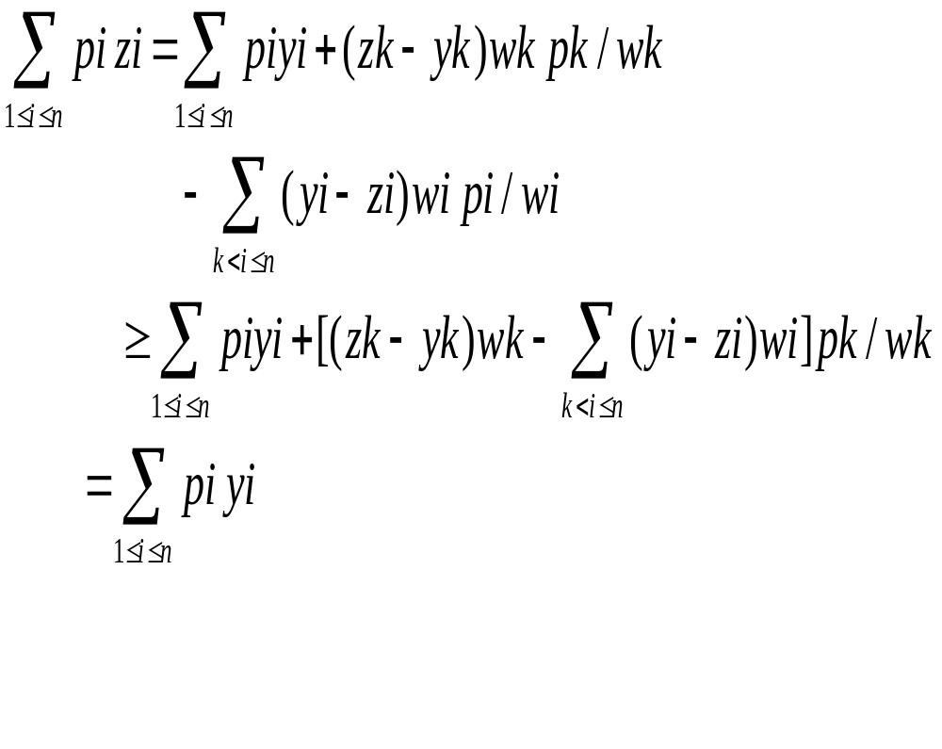
pk
pi

Slide 27
If Σ pi zi > Σ pi yi then y could not have been optimal solution.

Slide 28
If these sums are equal then either z = x and x is optimal or z ≠ x.
In the latter case repeated use of above argument y can be transformed into x without changing the utility value,and thus x too is optimal

Slide 29
Optimal 2-way Merge patterns and Huffman Codes:
Example. Suppose there are 3 sorted lists L₁, L₂, and L₃, of sizes 30, 20, and 10, respectively, which need to be merged into a combined sorted list, but we can merge only two at a time.
We intend to find an optimal merge pattern which minimizes the total number of comparisons.
For example, we can merge L₁ and L₂, which uses 30 + 20 = 50 comparisons resulting in a list of size 50.
We can then merge this list with list L₃, using another 50 + 10 = 60 comparisons,
so the total number of comparisons 50 + 60 = 110.

Slide 30
Alternatively, we can first merge lists L₂ and L₃,
using 20 + 10 = 30 comparisons,
the resulting list (size 30) can then be merged with list L₁,
for another 30 + 30 = 60 comparisons.
So the total number of comparisons is 30 + 60 = 90.
It doesn’t take long to see that this latter merge pattern is the optimal one.

Slide 31
Binary Merge Trees:
We can depict the merge patterns using a binary tree, built from the leaf nodes (the initial lists) towards the root in which each merge of two nodes creates a parent node whose size is the sum of the sizes of the two children. For example, the two previous merge patterns are depicted in the following two figures:

Slide 32
Cost = 30*2 + 20*2 + 10*1 = 110
Cost = 30*1 + 20*2 + 10*2 = 90
Merge L₁ and L₂, then with L₃
Merge L₂ and L₃, then with L₁
60
60
50
10
30
30
30
20
20
10
merge cost = sum of all weighted external path lengths

Slide 33
Optimal Binary Merge Tree Algorithm:
Input: n leaf nodes each have an integer size, n ≥ 2.
Output: a binary tree with the given leaf nodes which has a minimum total weighted external path lengths
Algorithm:
(1) create a min-heap T[1..n ] based on the n initial sizes. (2) while (the heap size ≥ 2) do (2.1) delete from the heap two smallest values, call them a and b, create a parent node of size a + b for the nodes corresponding to these two values (2.2) insert the value (a + b) into the heap which corresponds to the node created in Step (2.1)
When the algorithm terminates, there is a single value left in the heap whose corresponding node is the root of the optimal binary merge tree. The algorithm’s time complexity is O(n lgn) because Step (1) takes O(n) time; Step (2) runs O(n) iterations, in which each iteration takes O(lgn) time.

Slide 34
Example of the optimal merge tree algorithm:
2
3
5
7
9
Initially, 5 leaf nodes with sizes
5
Iteration 1: merge 2 and 3 into 5
2
3
5
7
9
10
Iteration 2: merge 5 and 5 into 10
5
5
16
Iteration 3: merge 7 and 9 (chosen among 7, 9, and 10) into 16
2
3
7
9
26
Iteration 4: merge 10 and 16 into 26
10
16
5
5
7
9
Cost = 2*3 + 3*3 + 5*2 + 7*2 + 9*2 = 57.
2
3

Slide 35
Proof of optimality of the binary merge tree algorithm:
We use induction on n ≥ 2 to show that the binary merge tree is optimal in that it gives the minimum total weighted external path lengths (among all possible ways to merge the given leaf nodes into a binary tree). (Basis) When n = 2. There is only one way to merge two nodes. (Induction Hypothesis) Suppose the merge tree is optimal when there are k leaf nodes, for some k ≥ 2. (Induction) Consider (k + 1) leaf nodes. Call them a₁, a₂, …, and a_{k+1}. We may assume nodes a₁, a₂ are of the smallest values, which are merged in the first step of the merge algorithm into node b. We call the merge tree T, the part excluding a₁, a₂ T’ (see figure). Suppose an optimal binary merge tree is S. We make two observations. (1) If node x of S is a deepest internal node, we may swap its two children with nodes a₁, a₂ in S without increasing the total weighted external path lengths. Thus, we may assume tree S has a subtree S’ with leaf nodes x, a₂, …, and a_{k+1}. (2) The tree S’ must be an optimal merge tree for k nodes x, a₂, …, and a_{k+1}. By induction hypothesis, tree S’ has a total weighted external path lengths equal to that of tree T’. Therefore, the total weighted external path lengths of T equals to that of tree S, proving the optimality of T.
T
S
T’
S’
b
x
a₁
a₂
a₁
a₂

Slide 36
Minimum Spanning Tree problem
Kruskal’s Algorithm
Prim’s algorithm
Both are based on greedy algorithm
Algorithm and proof of getting optimal solution

Slide 37
Minimum Spanning Tree
Spanning subgraph
  Subgraph of a graph G containing all the vertices of G
Spanning tree
  Spanning subgraph that is itself a (free) tree
Minimum spanning tree (MST)
  Spanning tree of a weighted graph with minimum total edge weight
Applications
  Communications networks
  Transportation networks
ORD
10
1
PIT
DEN
6
7
9
3
DCA
4
STL
8
5
2
DFW
ATL

Slide 38
Greedy Algorithms
We are trying to solve a problem in an optimal way.
We start with a set of candidates
As the algorithm proceeds, we keep two sets, one for candidates already chosen, and one for candidates rejected.
Functions exist for choosing the next element and testing for solutions and feasibility.
Let’s identify these points for the Making Change problem.

Slide 39
Minimum Spanning Trees
Given G={N,A }, G is undirected and connected
Find T, a subset of A, such that the nodes are connected and the sum of the edge weights is minimized. T is a minimum spanning tree for G.
1
2
1
2
3
6
5
4
4
6
3
8
4
5
6
4
3
7
7

Slide 40
Minimum Spanning Trees
How many edges in T?
Let’s come up with some algorithms to compute MSTs.
1
2
1
2
3
4
3
4
5
6
4
3
7

Slide 41
Algorithm #1
Start with an empty set.
From all the unchosen and unrejected edges, select the shortest edge.
1
2
1
2
3
6
5
4
4
6
3
8
4
5
6
4
3
7
7

Slide 42
Algorithm #1
Note we actually have multiple “correct” answers.
Sometimes, not just one MST.
1
2
1
2
3
6
5
4
4
6
3
8
4
5
6
4
3
7
7

Slide 43
MST
We keep two sets, one for candidates already chosen, and one for candidates rejected.
Functions exist for choosing the next element and testing for solutions and feasibility.
1
2
1
2
3
6
5
4
4
6
3
8
4
5
6
4
3
7
7

Slide 44
Kruskal’s Algorithm
Each node is in its own set
Sort edges in increasing order
Add shortest edge that connects two sets
1
2
1
2
3
6
5
4
4
6
3
8
4
5
6
4
3
7
7

Slide 45
Kruskal’s Algorithm
1
2
1
2
3
6
5
4
4
6
3
8
4
5
6
4
3
7
7
S = {1} {2} {3} {4} {5} {6} {7}
E = (1-2) (2-3) (6-7) (4-5) (1-4) (2-5) (4-7) (3-5) (2-4) (3-6) (6-7)

Slide 46
Kruskal’s Algorithm
1
2
1
2
3
6
5
4
4
6
3
8
4
5
6
4
3
7
7
S = {1, 2} {3} {4} {5} {6} {7}
E = (1-2) (2-3) (6-7) (4-5) (1-4) (2-5) (4-7) (3-5) (2-4) (3-6) (6-7)

Slide 47
Kruskal’s Algorithm
1
2
1
2
3
6
5
4
4
6
3
8
4
5
6
4
3
7
7
S = {1, 2, 3} {4} {5} {6} {7}
E = (1-2) (2-3) (6-7) (4-5) (1-4) (2-5) (4-7) (3-5) (2-4) (3-6) (6-7)

Slide 48
Kruskal’s Algorithm
1
2
1
2
3
6
5
4
4
6
3
8
4
5
6
4
3
7
7
S = {1, 2, 3} {4} {5} {6, 7}
E = (1-2) (2-3) (6-7) (4-5) (1-4) (2-5) (4-7) (3-5) (2-4) (3-6) (6-7)

Slide 49
Kruskal’s Algorithm
1
2
1
2
3
6
5
4
4
6
3
8
4
5
6
4
3
7
7
S = {1, 2, 3} {4, 5} {6, 7}
E = (1-2) (2-3) (6-7) (4-5) (1-4) (2-5) (4-7) (3-5) (2-4) (3-6) (6-7)

Slide 50
Kruskal’s Algorithm
1
2
1
2
3
6
5
4
4
6
3
8
4
5
6
4
3
7
7
S = {1, 2, 3, 4, 5} {6, 7}
E = (1-2) (2-3) (6-7) (4-5) (1-4) (2-5) (4-7) (3-5) (2-4) (3-6) (6-7)

Slide 51
Kruskal’s Algorithm
1
2
1
2
3
6
5
4
4
6
3
8
4
5
6
4
3
7
7
S = {1, 2, 3, 4, 5, 6, 7}
E = (1-2) (2-3) (6-7) (4-5) (1-4) (2-5) (4-7) (3-5) (2-4) (3-6) (6-7)

Slide 52
Kruskal’s Algorithm
1
2
1
2
3
6
5
4
4
6
3
8
4
5
6
4
3
7
7
S = {1, 2, 3, 4, 5, 6, 7}
E = (1-2) (2-3) (6-7) (4-5) (1-4) (4-7)
Total = 1 + 2 + 3 + 3 + 4 + 4 = 17

Slide 53
Kruskal’s Algorithm
9
8
1
2
3
4
5
6
6
4
7
2
4
5
6
6
7
3
7
E = (5-6), (5-7), (6-3), (4-2), (1-4), (2-5)
Total = 2 + 3 + 4 + 4 + 5 + 6 = 24

Slide 54
Kruskal’s Algorithm
9
8
1
2
3
4
5
6
6
4
7
2
4
5
6
6
7
3
7
Another possible Minimum Spanning Tree:
E = (5-6), (5-7), (6-3), (4-2), (1-4), (4-7)
Total = 2 + 3 + 4 + 4 + 5 + 6 = 24

Slide 55
Timing Kruskal’s Algorithm
Each node is in its own set
Sort edges in increasing order
Add shortest edge that connects two sets
1
2
1
2
3
6
5
4
4
6
3
8
4
5
6
4
3
7
7

Slide 56
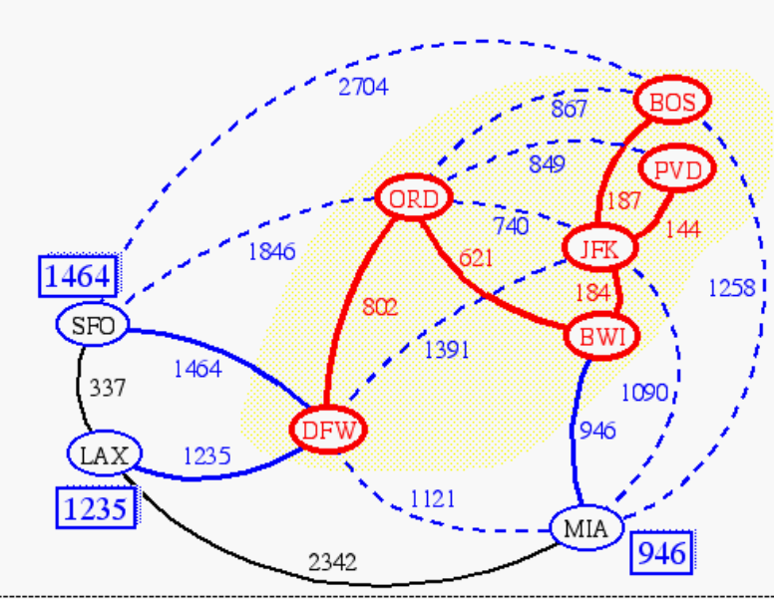
Prim-Jarnik’s Algorithm
We pick an arbitrary vertex s and we grow the MST as a cloud of vertices, starting from s
We store with each vertex v a label d(v) = the smallest weight of an edge connecting v to a vertex in the cloud
At each step:
  We add to the cloud the vertex u outside the cloud with the smallest distance label
  We update the labels of the vertices adjacent to u

Slide 57
Example
∞
7
2
7
D
2
7
D
B
4
B
4
8
9
∞
5
9
∞
2
5
F
2
5
F
C
8
C
8
8
3
8
3
E
E
A
7
7
A
7
7
0
0
7
7
2
7
D
7
D
B
4
2
B
4
5
9
∞
9
4
2
5
F
5
5
C
2
F
8
C
8
8
3
3
E
8
A
7
E
0
7
A
7
7
0

Slide 58
Example (contd.)
7
2
7
D
B
4
5
9
4
2
5
F
C
8
8
3
E
A
7
3
7
0
7
D
2
B
4
5
9
4
2
5
F
C
8
8
3
E
A
7
3
0

Slide 59
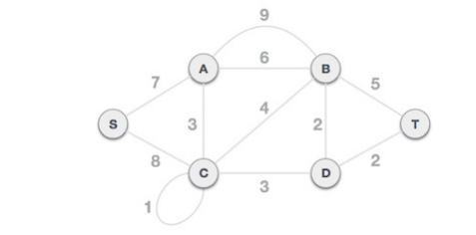
Prim’s algorithm

Slide 60
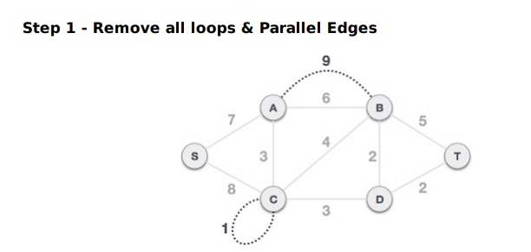

Slide 61
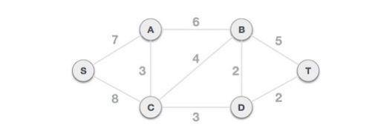

Slide 62
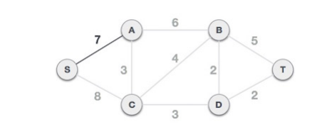
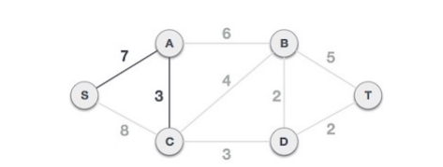
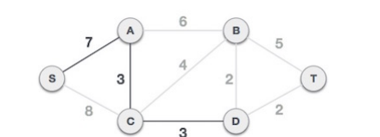

Slide 63
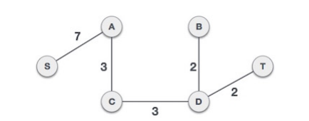

Slide 64
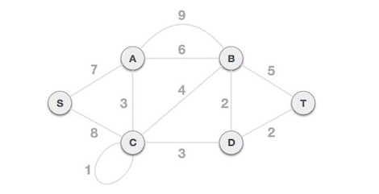
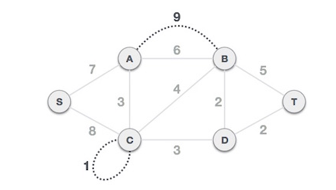
Kruskal’s algorithm

Slide 65
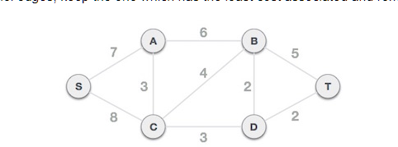

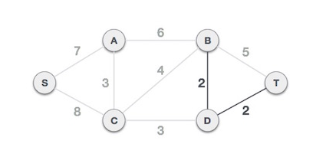
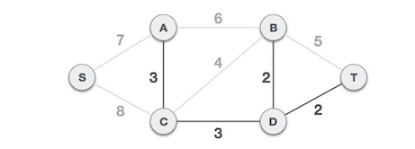

Slide 66
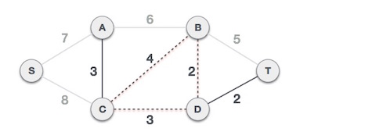
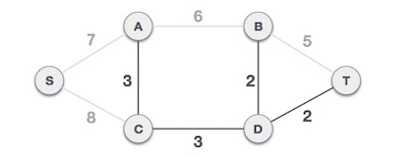
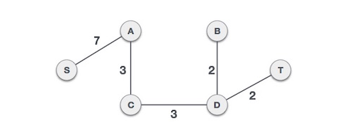

Slide 67
Kruskal’s Algorithm generates optimal spanning tree

Slide 68
Let
T: Sp.tree obtained by Kruskal’s algorithm
T’: Optimal(min) spanning tree
| E(T) | = | E(T’) | = n-1
where E(T) = edge set in T
If C(T) = C(T’) Nothing to prove T is also optimal.

Slide 69
So assume E(T) ≠ E(T’)
Let e be a min cost edge such that e is in E(T)
but not in E(T’)
It implies that all the edges of Sp tree T which are of lesser weight than e are also in T’.
Add e to T’
A cycle containing e
is formed in T’

Slide 70
Let e, e1, e2…. ek be this cycle.
At least one of these edges say ej will not be in T ?
If C(ej) < C(e) we can argue that it is not possible
If so Kruskal’s algorithm must have included it as ej must have been tried before . But ej is not in T so it means that ej was not selected there reason being it must be forming a cycle with edges already selected.Which is not true since all the preceding edges together with ej
are also present in T’ which is an acyclic graph..…..

Slide 71
So C(ej) >= C(e)
consider the spanning tree
E(T’’)= E( T’) +{e)-{ej}
C(T”)<= C(T’) which implies C(T’)=C(T’’)
so T’’ is of same cost as T’
T’’ is more similar to T than T’
By repeated use of above argument T’’ can be modified to T’’’and so on and finally same as T
Thus C(T) =C(T’)

Slide 72
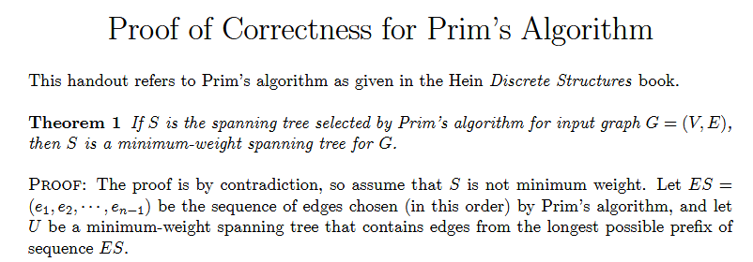

Slide 73
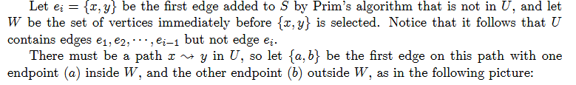
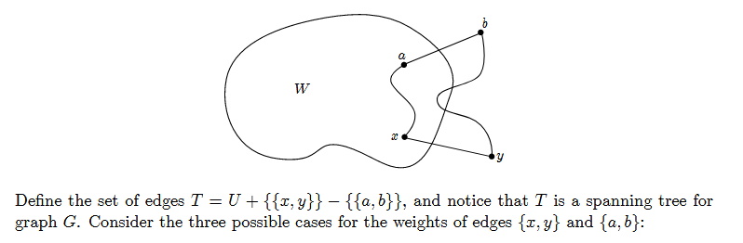

Slide 74
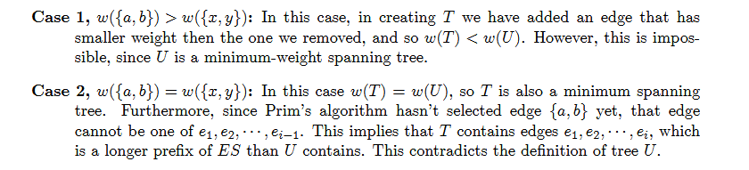

Slide 75
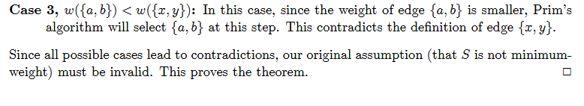

Slide 76
The time complexity is O(VlogV + ElogV) = O(ElogV),
making it the same as Kruskal's algorithm.
However, Prim's algorithm can be improved using
Fibonacci Heaps (cf Cormen) to O(E + logV).

Slide 77
Huffman Codes
Very effective technique for compressing data; saving of 20% to 90%.
It uses a table of frequencies of occurrence of characters.

Slide 78
Fixed length code
If only six different characters are used in a text then we need 3 bits to represent six characters.
a = 000; b = 001; …f = 101.
This method thus requires 300,000 bits to code the entire file having 100,000 characters.

Slide 79
Variable Length code
We can do considerable better by giving frequent characters short code words and infrequent characters log code words.
frequency | 45 13 12 16 9 5
Fixed len codeword Var. length code | 000 001 010 011 100 101 0 101 100 111 1101 1100
a b c d e f

Slide 80
Thus using variable length code it requires
(45.1 +13.3 + 12.3 + 16.3 + 9.4 + 5.4)1000
= 224,000 Bits instead of 300,000 bits
Thus saving approx 25%.

Slide 81
Prefix code: no code word is also a prefix of some other codeword.
These prefix codes are desirable because they simplify decoding.
0 101 100 111 1101 1100
Like in our example
001011101 can be parsed uniquely as
0-0-101-1101 which decodes as aabe
a b c d e f

Slide 82
Huffman Encoding
Compression
  Typically, in files and messages,
    Each character requires 1 byte or 8 bits
Question
  What’s the smallest number of bits that can be used to store an arbitrary piece of text?
Idea
  Find the frequency of occurrence of each character
  Encode Frequent characters short bit strings
  Rarer characters longer bit strings

Slide 83
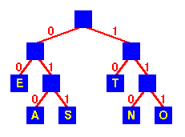
Huffman Encoding
Encoding
  Use a tree
  Encode by following
  tree from root to leaf
  eg
    E is 00
    S is 011
  Frequent characters
  E, T 2 bit encodings
  Others
  A, S, N, O 3 bit encodings

Slide 84

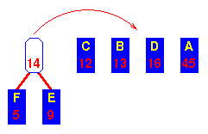
Huffman Encoding - Operation
Initial sequence
Sorted by frequency
Combine lowest two
into sub-tree
Move it to correct
place

Slide 85
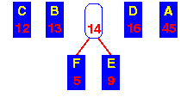
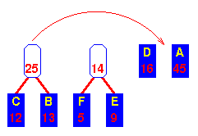
After shifting sub-tree
to its correct place ...
Combine next lowest
pair
Move sub-tree to
correct place

Slide 86
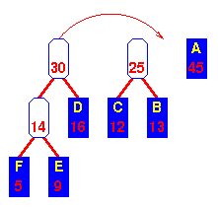
Move the new tree
to the correct place ...
Now the lowest two are the
“14” sub-tree and D
Combine and move to
correct place

Slide 87
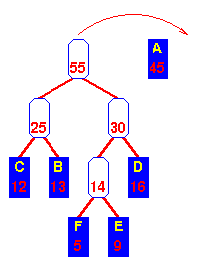
Move the new tree
to the correct place ...
Now the lowest two are the
the “25” and “30” trees
Combine and move to
correct place

Slide 88
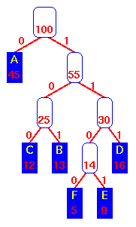
Combine
last two trees
A 0 D 111
B 101 E 1101
C 100 F 1100

Slide 89
A 0 D 111
B 101 E 1101
C 100 F 1100

Slide 90
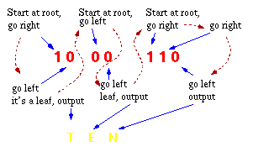

Slide 91
Huffman Encoding - Time Complexity
Sort keys O(n log n)
Repeat n times
  Form new sub-tree O(1)
  Move sub-tree O(logn)
  (binary search)
  Total O(n log n)
Overall O(n log n)

Slide 92
It is a lossless data compressing technique generating variable length codes for different symbols.
It is based on greedy approach which considers frequency/probability of alphabets for generating codes.

Slide 93
Problem-
A file contains the following characters with the frequencies as shown.
If Huffman Coding is used for data compression, determine-
Huffman Code for each character
Average code length
Length of Huffman encoded message (in bits)

Slide 94
Characters | Frequencies
a | 10
e | 15
i | 12
o | 3
u | 4
s | 13
t | 1

Slide 95
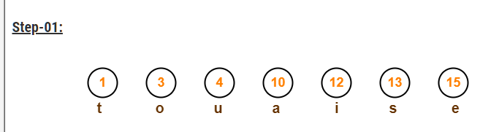
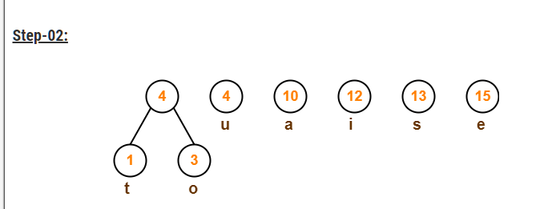

Slide 96
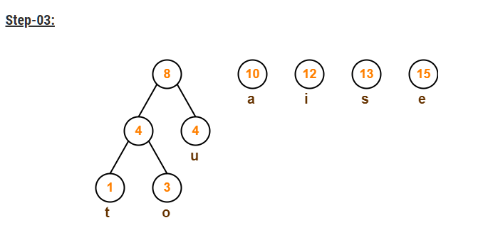
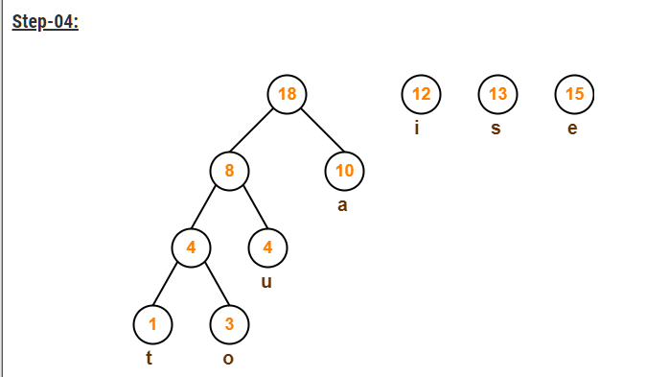

Slide 97
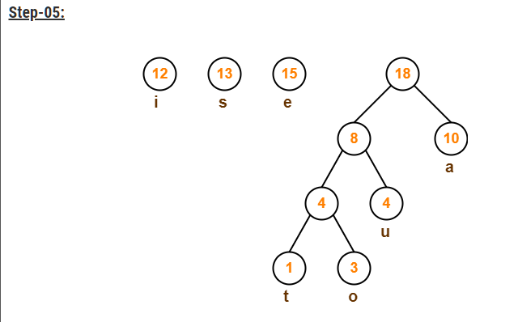

Slide 98
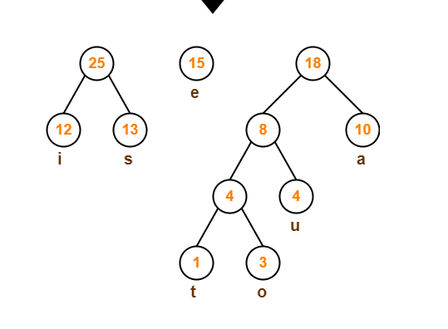

Slide 99
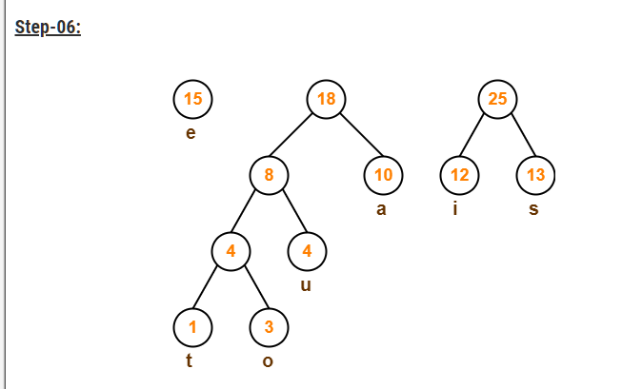
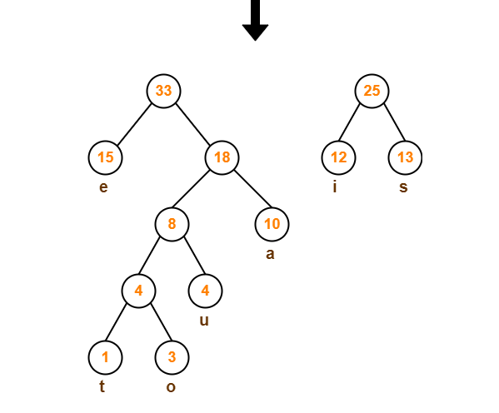

Slide 100
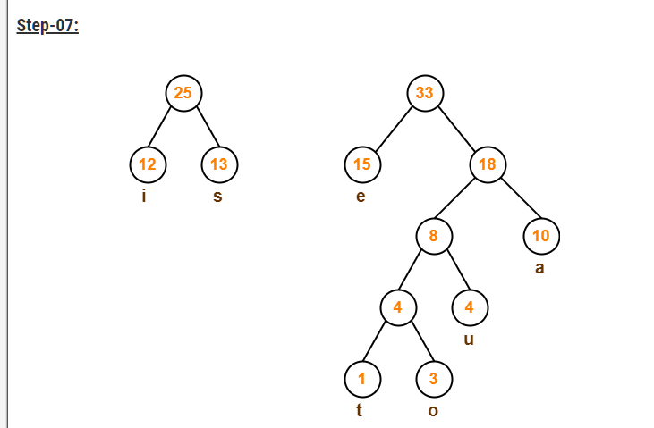
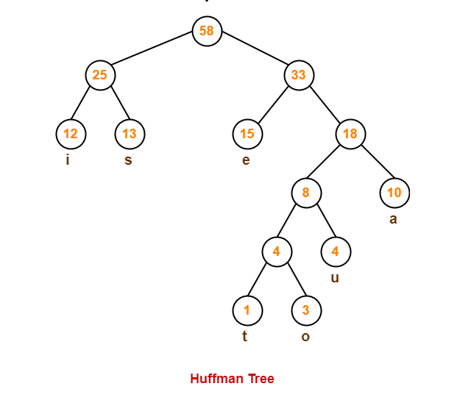

Slide 101
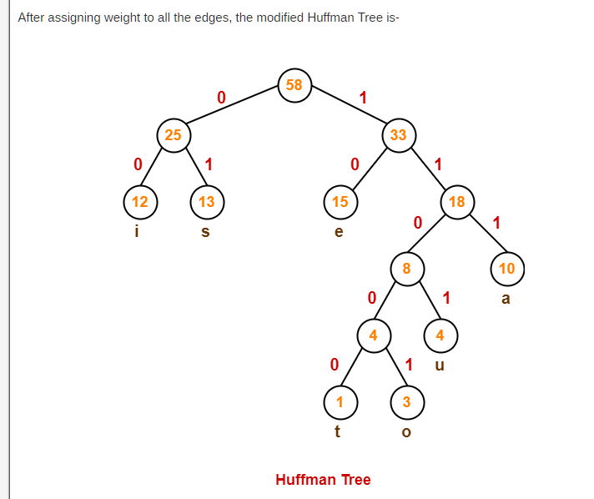
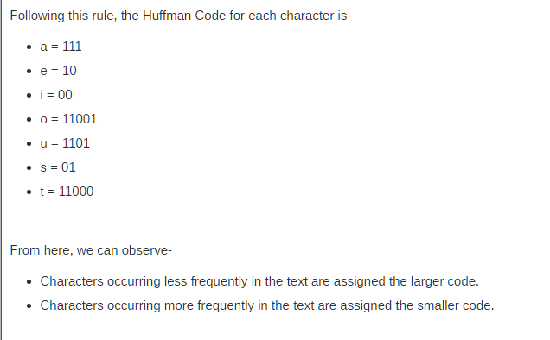

Slide 103
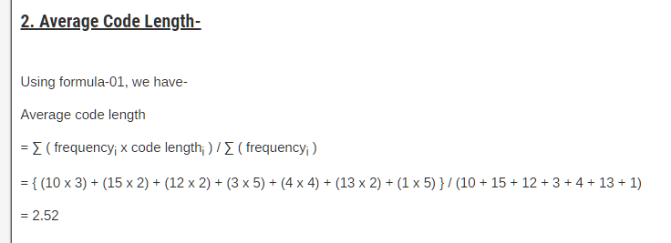

Slide 104
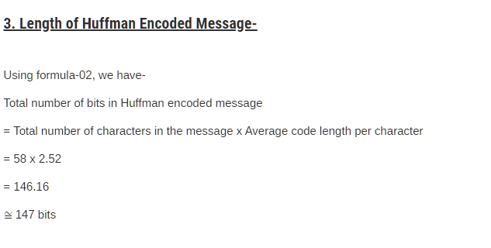

Slide 105
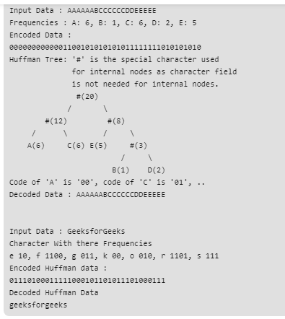

Slide 106
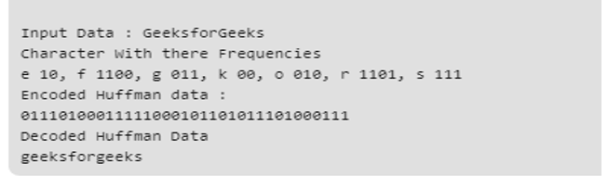

Slide 108
The characters a to h have the set of frequencies based on the first 8
Fibonacci numbers as follows:
a : 1, b : 1, c : 2, d : 3, e : 5, f : 8, g : 13, h : 21
A Huffman code is used to represent the characters.
What is the sequence of characters corresponding to the following code?
110111100111010

Slide 109
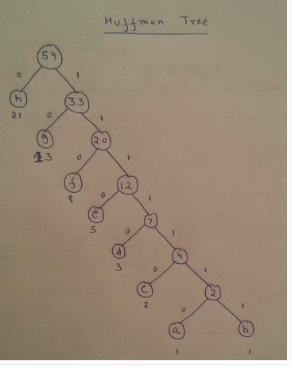

Slide 110

Q What is the sequence of characters corresponding to the following code?
110111100111010
110 11110 0 1110 10
f d h e g

Slide 111
Theorem
Let C be an alphabet in which each character c of C has frequency f(c ) .
Let x and y be two characters in C having lowest frequencies.
Then there exists an optimal prefix code for C in which the code words for x and y have the same length and differ only in the last bit.

Slide 112
T:
T’:
a
x
y
y
a
b
x
b
Let a and b be two characters that are sibling leaves of maximum depth in T.
We can assume f(a) ≤ f(b) and f(x) ≤ f(y)
Since x and y are of lowest frequencies
f(x) ≤ f(a) and f(y) ≤ f(b)

Slide 113
T’’:
a
b
x
y

Slide 114
The number of bits required to encode a file is
B(T) = ∑f (c ) d _{T}(c)
we can call it the cost of the tree T.
B(T) – B(T’) = ∑f (c ) d _{T}(c) - ∑f (c ) d _{T’}(c)
= f(x) d_{T}(x) + f(a) d_{T}(a) - f(x) d_{T}’(x) – f(a) d_{T}’(a)
= f(x) d_{T}(x) + f(a) d_{T}(a) - f(x) d_{T}(a) – f(a) d_{T}(x)
=(f(a) – f(x))(d_{T}(a) – d_{T}(x))
>= 0 because both
f(a)-f(x) and d_{T}(a) – d_{T}(x) are nonnegative.

Slide 115
Similarly exchanging y and b does not increase the cost so
B(T’) - B(T’’) is non negative.
There fore
B(T’’) ≤ B(T)
And since T was taken to be optimal
B(T) ≤ B(T’’)
Which implies
B(T’’) =B(T)
Thus T’’ is an optimal tree in which x and y appear as sibling leaves of maximum depth.

Slide 116
Theorem - Let C be a given alphabet with frequency f(c). Let x and y be two characters in C with minimum frequencies. Let C’ be the alphabet obtained from C as
C’ = C-{x,y}∪{z}.
Frequencies for new set is same as for C except that f(z) = f(x) + f(y).
Let T’ be any optimal tree representing optimal code for C’, then the tree T obtained from T’ by replacing the leaf node for z with an internal node having x and y as children, represents an optimal prefix code for the alphabet C

Slide 117
Proof: For any c ε C – {x ,y}
d_{T}(c ) = d_{T}’(c ) but for x and y
d_{T}(x) = d_{T}(y) = d_{T}’(z) + 1
We have
f(x)d_{T}(x) + f(y) d_{T}(y) = (f(x) + f(y) )(d_{T}(z) + 1)
= f(z) d_{T}(z) + (f(x) + f(y))
B(T) = B(T’) + f(x) + f(y)

Slide 118
From which we conclude that
B(T) = B(T’) + f(x) + f(y)
Or
B(T’) = B(T) – f(x) – f(y)
We now prove by contradiction.
Suppose that T is not optimal for C then there is another optimal tree T’’ such that
B(T’’) < B(T)
Without any loss of generality we can assume that x and y are siblings here.
Let T’’’ be the tree obtained from T’’with the common parent of x and y replaced by a leaf z with freq f(z) = f(x) +f(y)
then

Slide 119
B(T’’’) = B(T’’) – f(x) – f(y)
< B(T) – f(x) – f(y)
=B(T’)
This contradicts the assumption that T’ represents an optimal prefix code for C’
Thus T must represent an optimal prefix code for the alphabet C.

Slide 120
Job Sequencing with dead lines
We are given n jobs,
associated with each job i, here is an (integer) deadline d_{i} ≥ 0 and a profit p_{i} > 0.
This profit pi will be earned only if job is completed before its deadline.
Each job needs processing for one unit time on a single machine available.
Feasible solution-is a subset of jobs each of which can be completed without crossing any deadline.
Optimal solution is a feasible solution with maximum profit

Slide 121
Example: n=4 , p=(100,10,15,27) and d=(2,1,2,1)
Possible feasible solutions:
Subset sequence value
{1,2} 2,1 110
{1,3} 1,3 or 3,1 115
{1,4} 4,1 127
{2,3} 2,3 25
{3,4} 4,3 42
{1} 1 100

Slide 122
Greedy approach
objective is to maximize ∑pi
So next job to select in J is the one that increases ∑pi the most,
subject to the restriction that set J remains feasible.
Feasibility test becomes very easy through the following result

Slide 123
Theorem: Let J be a set of k jobs and
S= i₁,i₂,….i_{k} a permutation of jobs in J such that d_{i1} ≤ d_{i2} ≤ ≤ d_{ik}. Then J is feasible iff the jobs in J can be processed in the order S without violating any deadline.
Proof:
We need to show that if J is feasible set then a permutation S =i₁,i₂ …i_{k} with d_{i1} ≤ d_{i2} ≤ d_{ik} is also feasible.
If J is taken to be a feasible set then there exists S` = r₁, r₂….r_{k} such that d_{rq} ≥ q, 1 ≤ q ≤ k.
Assume S ≠ S`,

Slide 124
Let a be the least index such that r_{a} ≠ i_{a}.
Let i_{a} = r_{b} for some b > a
In S’ we can interchange r_{a} and r_{b} .since d_{ra} d_{rb} the resulting permutation s’’
S: i₁ i₂ . . . ia … i_{k}
S’: r₁ r₂ r_{a} r_{b} r_{k}
(b)
d_{ia}<=d_{ra}
Since S is a permutation of jobs with nondecreasing deadlines.and r_{a} is positioned later than i_{a}
If we interchange r_{a} and r_{b} we get another feasible sequence. And new sequence is closer to S.
Continuing in this way S` can be transformed into S without violating any dead line.
b

Slide 125
Theorem: greedy approach always obtains an optimal solution for job sequencing with dead lines
Proof: Let I be the set of jobs obtained by greedy method.
And let J be the set of jobs in an optimal solution.
We will show that I and J both have same profit values.
We assume that I ≠ J.
J cannot be subset of I as J is optimal
Also I can not be subset of J by the algo.

Slide 126
So there exists a job a in I such that a is not in J
And a job b in J Which is not in I
Let us take a “a highest profit job” such that a is in I and not in J.
Clearly p_{a} ≥ p_{b} for all jobs that are in J but not in I.
Since if p_{b} > p_{a} then greedy approach would consider job b before job a and included into I.
Let Si and Sj be the feasible sequences for feasible sets I and J.

Slide 127
We will assume that common jobs of I and J can be processed in same time intervals.
Let i be a job scheduled in t to t+1 in S i and t’ to t’+1 in Sj
If t < t’ then interchange the job if any in [t’ , t’+1] in Si with job i.
Similarly if t’ < t similar transformation can be done in Sj

Slide 128
Now consider the interval [ ta, ta+1] in Si in which job a is scheduled.
Let b the job(if any) scheduled in Sj in this interval.
p_{a} ≥ p_{b} from the choice of a
So scheduling a from ta to ta+1 in Sj and discarding job b gives a feasible schedule for the set J’ = J- {b} + {a}.
Clearly J’ has profit no less than that of J and differs from I in one less job than J does.
By repeatedly using this approach J can be transformed into I without decreasing the profit value.

Slide 129
Shortest path problem
Suppose we have a graph that represents the high way system of a state or country. In this graph , the vertices represent cities and the edges represent sections of the high way. Each edge has a weight representing the distance between the two cities connected by the edge.
A motorist wishing to derive from city A to city b would be interested answers to the following questions:
Is there a path from A to B?
If there are more than one path from A to B which path is the shortest.

Slide 130
The problem of finding shortest path from a specified
Vertex S to another specified vertex T can be stated as
follows:
A simple weighted digraph G on vertex is described
by an N*N , weight matrix D where
d_{ij}=length of the directed edge from vertex i to
vertex j, dij >= 0
d_{ij} =0
d_{ij} = α if there is no edge from i to j

Slide 131

In general d_{ij} d_{ji ,}and triangle inequality need not be
Satisfied , ie d_{ij +} d_{jk} may be less than d_{ik .}
The distance of a directed path P is defined as the sum
of the lengths of the edge in P.
The problem is to find the shortest path and its distance
(length) from a starting vertex S to a terminal vertex T.

Slide 132
Dijkstra’s Algorithm
d[i,j] – Weight of the arc from i to j
Distance[i] – keeps the distance of the shortest path known
thus far from s to i.
Initially distance[s]=0 and distance[i] = α for all i ≠ s
A set perm contains all nodes whose minimal(coverall)distance
from s is known – i.e, those nodes whose distance value
is permanent and will not get changed.
If i is a member of perm, distance[i],is minimal
distance from s to i.

Slide 133
Initially only member of perm is s.
As soon as t becomes a member of perm, algorithm terminates.
The algorithm maintains a variable “current “ which is the
node that has been added to perm, most recently. Initially
Current =s. Whenever a node current is added to perm,
distance must be recomputed for all vertices which
are successors of current.
For every successor i of current
if distance[current]+weight[current,i] is less than
(distance from s to i through current is smaller than)
any other distance from s to i found thus far t
Thus
Distance[i] must be reset.

Slide 134
The distances have to be recomputed to every successor
of current
distance[j] represents the shortest path from
s to j that includes only members of perm(except for
i itself).This means that for the node k, not in perm and
for which distance [k] is smallest, there is no path from
s to k, whose length is shorter than distance[k] thus k
can be added to perm. Current is then reset to k and
process is repeated

Slide 135
A Greedy algorithm due to Dijkstra which finds these shortest paths in sequence can be described as follows: find the shortest among all shortest paths (from the source), then find the second shortest, etc., breaking ties arbitrarily, until all shortest paths are found. During the process, the collection of all the shortest paths determined so far form a tree; the next shortest path is selected by finding a node that is one edge away from the current tree and has the shortest distance measured from the source

Slide 136
2
a
d
8
7
2
2
1
10
b
3
e
2
g
4
1
4
7
c
f
3

Slide 137
A | B | C | D | E | F | G
α |  | α | α | α | α | α
7 |  | 1 | α | α | α | α
7 |  |  | α | α | α | α
4 |  |  | α | 5 | 4 | α
4 |  |  | α | 5 |  | α
4 |  |  | 14 | 5 |  | 11
 |  |  | 14 | 5 |  | 11
 |  |  | 12 | 5 |  | 11
 |  |  | 12 |  |  | 11
 |  |  | 12 |  |  | 7
 |  |  | 12
0
0
0
1
0
1
0
1
4
0
1
4
4
0
1
4
4
0
1
4
4
0
1
5
4
4
0
1
5
4
4
0
1
5
4
7

Slide 138
Path can also determined moving backward.
Start back from node G till we find a place where
present value of distance is obtained. At that place
the current gives the node which precedes G.
B C E G

